Slide 1

is Data science really the sexiest job of 21st century? Find out !

Slide 2
Agenda
At the end of the session, you will be able to know:
Why Data Science is the most sought after job in 2015?
Career Opportunities with Data Science
Advantages Data Science
Understand how Companies are using Data Science?

Slide 3
Why Data Science is the most sought after job in 2015?

Slide 4


Data Science a Dream Job
Fortune 100 Companies boards
the data science Flight
With the data science trend gaining momentum, legacy firms build up
their data science teams
Analysts get a salary band lift
Companies looking to recruit Data Scientists need to make sure their bands are competitive and think of other ways to lure talent, since they will be competing with multiple offers

Slide 5
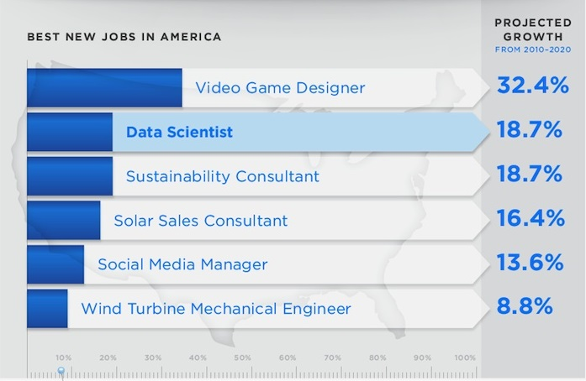
Top 6 Predicted Jobs in this Decade in US
As per the survey from Pinterest, Demand for Data science would be growing at a very high rate
Source : https://www.pinterest.com/tolgadurdu/the-age-of-big-data/

Slide 6
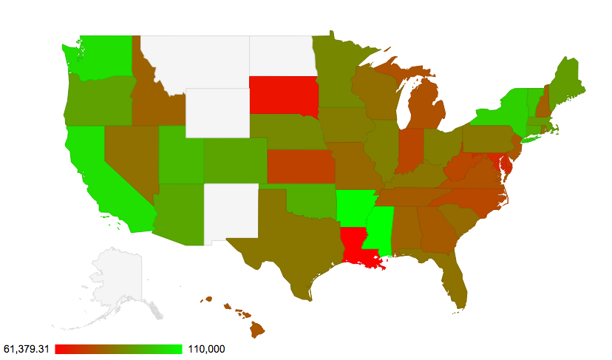
Data Scientist, IT Salary (Foreigners in US)
US – SD
Data Scientist Avg Base Salary : 65000
Number of H1B Filings : 2
US – CA
Data Scientist Avg Base Salary : 104149
Number of H1B Filings : 2081
US – LA
Data Scientist Avg Base Salary : 61379
Number of H1B Filings : 29
US – AR
Data Scientist Avg Base Salary : 109254
Number of H1B Filings : 25
Source : http://davocado.com/
The average base salary of foreign workers who got data science related job and in each state, based on disclosure data of foreign labor H1B certification application tables from 2012 – 2015 released by the US Department of Labor

Slide 7
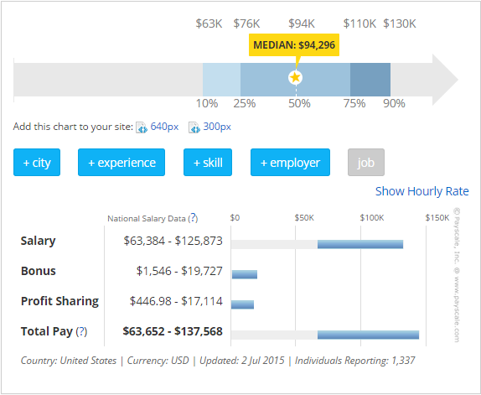
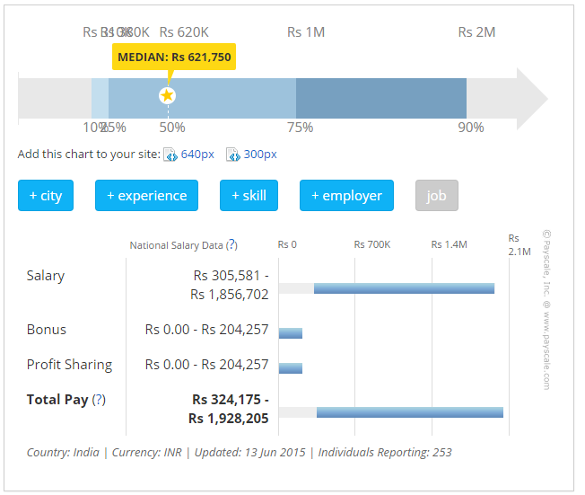
Data Scientist, IT Salary
There is rapid growth in the salaries of a data scientist all around the globe
US
India
Source : www.payscale.com

Slide 8
Decoding Data Science

Slide 9

What is Data Science
Data Science is the study of extraction of knowledge from data.
It includes varying elements and is build on techniques and theories from many fields like :
With the goal of extracting meaning from data and creating data products.
The title “Data Scientist” has been around for only a few years. (It was coined in 2008 by D.J. Patil and Jeff hammerbacher)
Machine
Learning
Computer
Programming
Mathematical
skills
Data
Engineering
Pattern
Recognition
Visualization

Slide 10
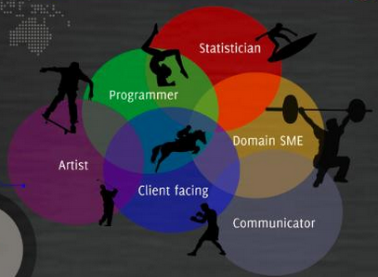
Data Science Practitioner : Data Scientist

Slide 11

Career Path
Skills Required
Job Roles
Statistical modeling and technical aptitude
Business Analyst
Business Acumen
Data Analyst
Programming
Data Scientist
Data warehousing
Junior Data Scientist
Business Intelligence
Decision Scientist

Slide 12
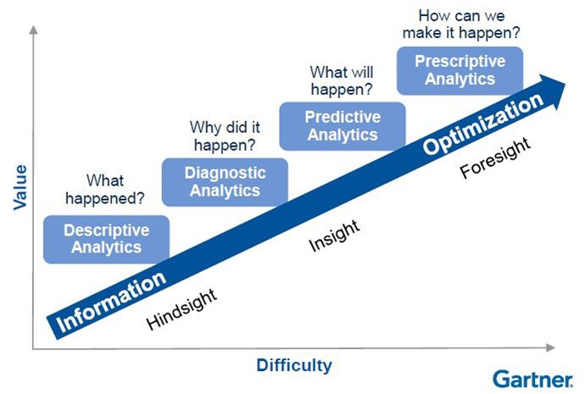
Advantages of Data Science
Use existing data to predict future business plan

Slide 13
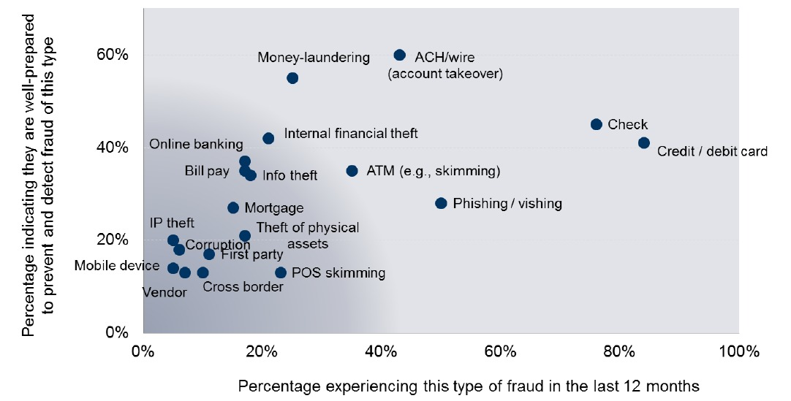
Advantages of Data Science
Mitigate Frauds By Proactive Detection using Predictive Analytics and Machine learning
Fact: Billions of dollars are lost every year because of the frauds in various domains
Aberdeen analyzed, different types of prevailing frauds and companies’ readiness to deal with that.
Certain financial frauds occur more frequently, but organizations are well prepared for such incidents such as check fraud, credit/debit card fraud,ACH fraud etc.
Source : http://v1.aberdeen.com/c/report/benchmark/8189-RA-fraud-big-data-visibility.pdf

Slide 14
Data Science Career Path

Slide 15
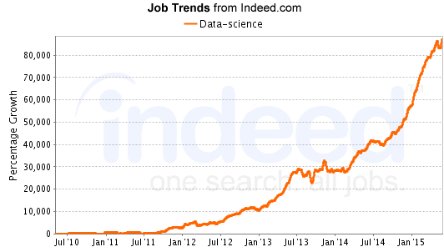
Job Opportunity

Slide 16









Major Companies Using Data Science

Slide 17
Real Life Application

Slide 18
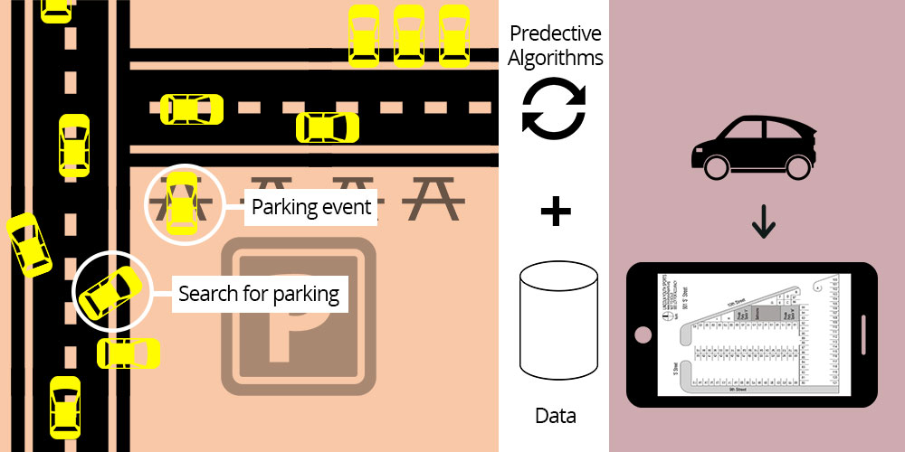
Application of Data science
BMW is using Predictive Analytics to find a place to park!
Source: http://fortune.com/tag/predictive-analytics/

Slide 19
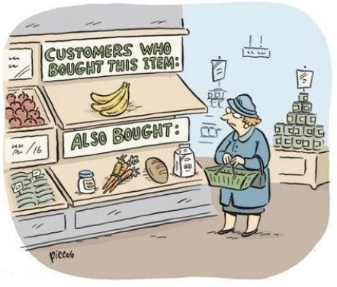


Application of Data science
E-Commerce using it for recommendation!
Source: http://fortune.com/tag/predictive-analytics/

Slide 20
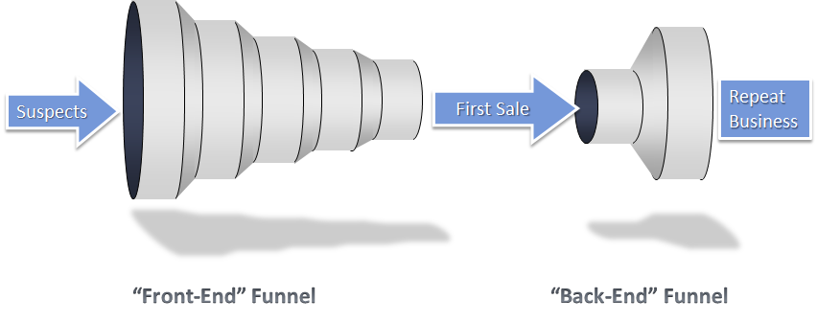
Application of Data science
Companies using it for Customer acquisition and repeat Business!
Journey from lead to a customer and becoming customer for more than one product/service
Source: http://www.forentrepreneurs.com/sales-funnel/

Slide 21






Application of Data science
Companies using it for Customer churn prevention!

Slide 22
Demo

Slide 23

The Big Question!
Is Data Scientist really the sexiest job of 21st century ?
Answer – Yes, it is really the sexiest job of 21st century.
They are the most adorable job in market.
They are the among the most paid job
They are difficult and expensive to hire and, given the very competitive market for their services, difficult to retain.
There simply aren’t a lot of people with their combination of scientific background and computational and analytical skills.

Slide 25
Survey

Slide 26
Survey

